Slide 1
Part I Syllabus – Fundamental Underlying Layers
Date​ | Subject​ | File​
Week 1:​ 9/Jan/2023​ 11/Jan/2023​ | Introduction: course logistics and Internet history​ | M1-L1-Introduction.pptx​
 | Layered Network Architecture​ | First part of M1-L2-Network Layer & Physical Resilience.pptx​
Week 2:​ 16/Jan/2023​ 18/Jan/2023​ | Physical Layer: Network Resilience​ | Second part of M1-L2-Network Layer & Physical Resilience.pptx​
 | Data link layer – Flow control​ | M1-L3-DLL-Flow Control.pptx​
Week 3:​​ 25/Jan/2023​ | Data link layer – Error control​ | M1-L4-DLL-Error Control.pptx​
Week 4:​ 30/Jan/2023​ 01/Feb/2023​ | Local area network – Introduction​ | M1-L5-LAN-Introduction.pptx​
 | Local area network – MAC​ | M1-L6-LAN-MAC.pptx​
Week 5:​ 06/Feb/2023​ 08/Feb/2023​ | Local area network – Ethernet​ | First part of M1-L7-LAN-Ethernet.pptx​
 | Local area network – Ethernet Evolutions​ | Second part of M1-L7-LAN-Ethernet.pptx​
Week 6:​ 13/Feb/2023​ 15/Feb/2023​ | Local area network – WLAN​ | M1-L8-LAN-WLAN.pptx​
 | Mobile Access Networks | M1-L9-Mobile.pptx
Week 7: 20/Feb/2023 22/Feb/2023 | E-learning for Network paradigms | M1-L10-Paradigms.pptx
 | Reviewing all contents taught in previous lectures

Slide 2


Which one is more valuable?

Slide 3

SC2008/CZ3006/CE3005 Computer Network
Lecture 2
Network Layers and Physical Resilience

Slide 4
Contents
Layered Network Architecture
Motivations and Benefits
OSI 7-Layer Model
Internet 5-Layer Implementation (i.e., TCP/IP)
Physical Resilience
Link Failure probability
Network resilience calculation

Slide 5
Layered Network Architecture

Slide 6
Motivations for Layered Network Architecture
Networks are complex with many pieces
Hosts, routers, links, applications, protocols, hardware, software
Dealing with complex systems
Explicit structure allowing identification, relationship of different pieces
Layered reference model for discussion
Modularization easing maintenance and updating
Change of layer’s service transparent to rest of system
Change in network technology does not affect rest of system
Layering (design vs implementation)

Slide 7
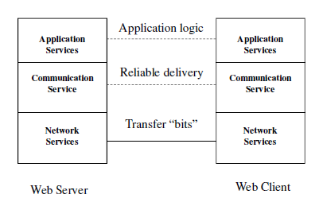
A Layered Example for Web
Browser requests web page from server
Server determine if access is granted
Reliable transfer page from server to client
Physical transfer of bits from server to client

Slide 8
Layered Network Architecture
Network organized as a stack of layers
Purpose of layer is to offer services to the layer above it and passes data & control information to the layer below, using a well-defined interface
Reducing design complexity
Protocols: a set of rules governing communication between two peering parties/computers
define format, order of messages sent and received among network entities, and actions taken on message transmission & receipt.
Network Architecture: a set of layers and protocols with specifications enabling hardware/software developers to build systems compliant with a particular architecture

Slide 9
Benefits of Layers
Simplicity
Easy to design once layers and their interactions are defined clearly
Flexibility
Easy to modify and develop networks by separate layers modifications
Incremental Changes
Easy to add new layers, add new functions to a layer

Slide 10
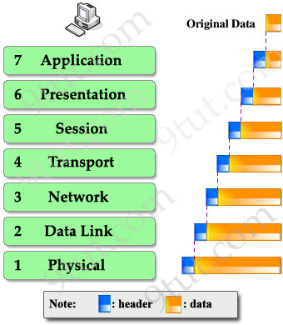
OSI 7-Layer Model
Function Decomposition
Weakly-decoupled stack
Encapsulation
Each layer adding new headers
Peering
Only peer layer “communicating” with each other

Slide 11
OSI Reference Model: 7 Layers (More on Supplementary Materials)
OSI Model
 | Data unit | Layer | Function
Host layers | Data | 7. Application | Network process to application
 |  | 6. Presentation | Data representation, encryption and decryption, convert machine dependent data to machine independent data
 |  | 5. Session | Inter-host communication, managing sessions between applications
 | Segment | 4. Transport | End-to-end connections, reliability and flow control
Media layers | Packet | 3. Network | Path determination and logical addressing
 | Frame | 2. Data link | Physical addressing
 | Bit | 1. Physical | Media, signal and binary transmission

Slide 12
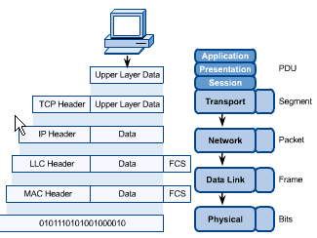
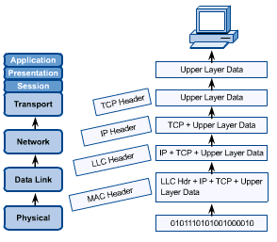
OSI in Action: Encapsulation
A message begins at the top application layer and moves down the OSI layers to the bottom physical layer
As the message descends, each successive OSI model layers adds a header to it
A header is layer-specific information that basically explains what functions the layer carries out
Conversely, at the receiving end, headers are stripped from the message as it travels up the OSI layers.

Slide 13


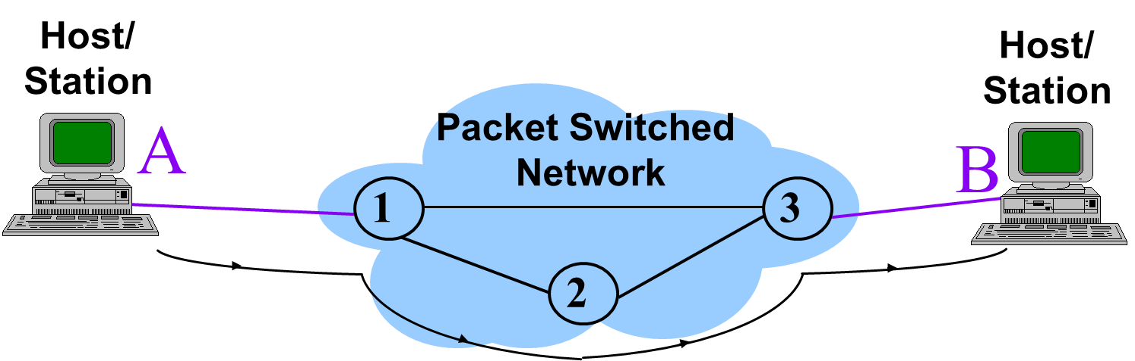
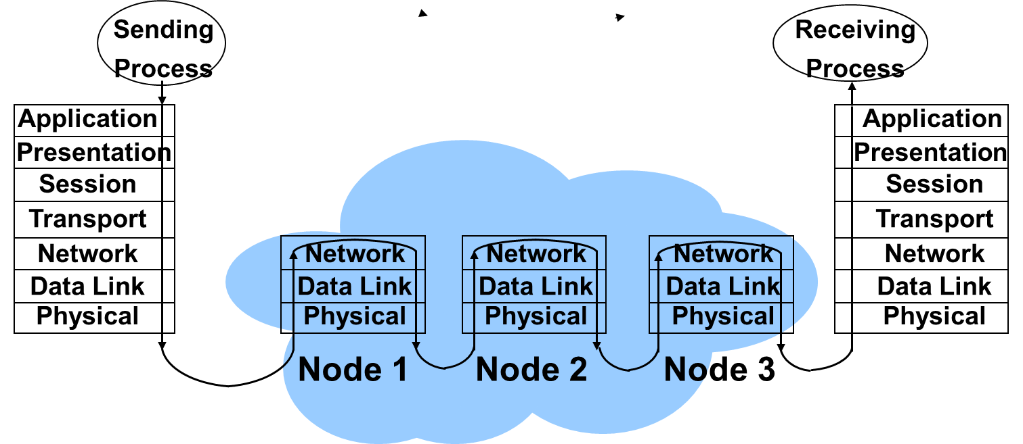
A Simple Computer Network
Undersea Cable
Your NTU Computer
SG Net Core
USA Net Core
USA guy
Packet Switched Network
(i.e., Network Core)

Slide 14
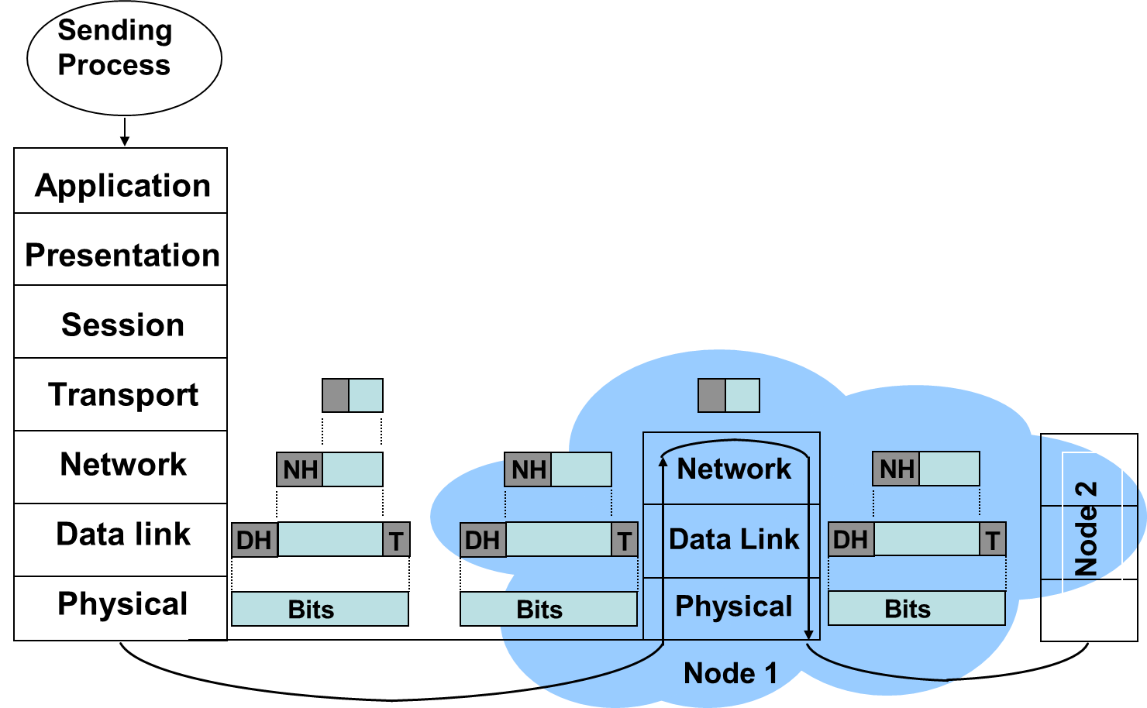
Header Processing at Switch Node

Slide 15
OSI Unified View: Protocols
Not Examinable
Layer n in one machine interacts with layer n in another machine to provide a service to layer n +1
The entities comprising the corresponding layers on different machines are called peer processes.
The machines use a set of rules and conventions called the layer-n protocol.
Layer-n peer processes communicate by exchanging Protocol Data Units (PDUs)
n-PDUs
n
Entity
n
Entity
Layer n peer protocol

Slide 16
OSI Unified View: Services
Not Examinable
Communication between peer processes is virtual and actually indirect
Layer n+1 transfers information by invoking the services provided by layer n
Services are available at Service Access Points (SAP’s)
Each layer passes data & control information to the layer below it until the physical layer is reached and transfer occurs
The data passed to the layer below is called a Service Data Unit (SDU)
SDU’s are encapsulated in PDU’s

Slide 17
Layers, Services & Protocols
Not Examinable
n+1
entity
n+1
entity
n-SDU
n-SDU
n-SAP
n-SAP
n-SDU
H
n entity
n entity
H
n-SDU
n-PDU

Slide 18
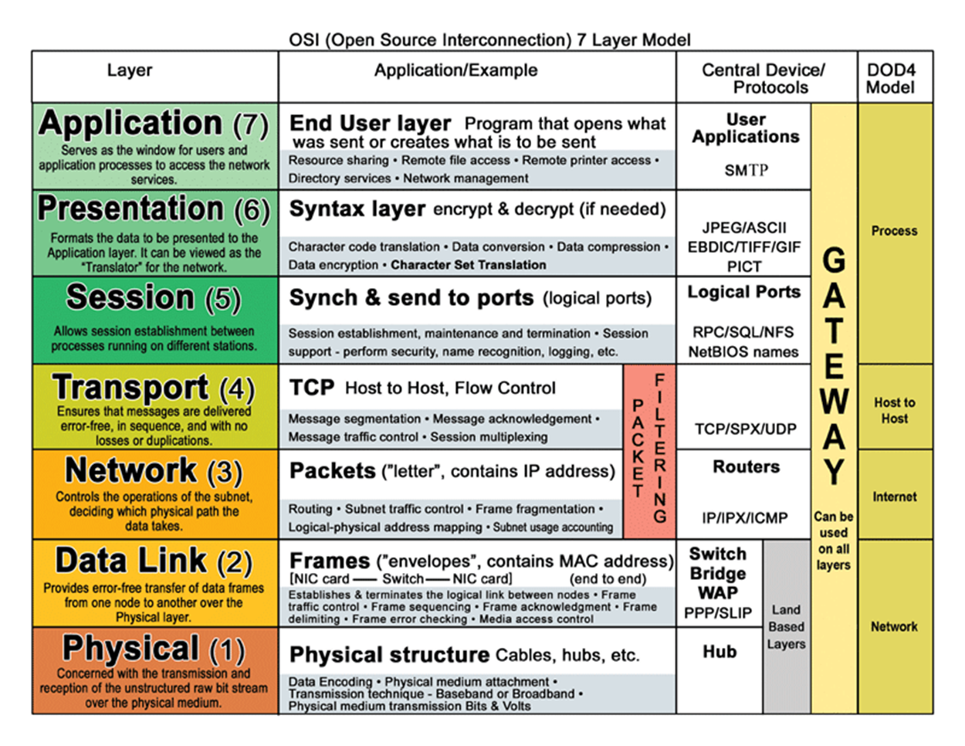
OSI Model in a Nutshell
Not Examinable

Slide 19
TCP/IP Model: 5 Layers
Application: supporting network applications
FTP, SMTP, HTTP
Transport: host-host data transfer
Transmission Control Protocol (TCP), UDP
Network: routing of datagrams from source to destination
Internet Protocol (IP), routing protocols
Link: data transfer between neighboring network elements
PPP, Ethernet
Physical: bits on the wire

Slide 20
TCP/IP Internetworking
Each layer takes data from above
Adds header information to create new data unit
Passes new data unit to layer below
router

Slide 21
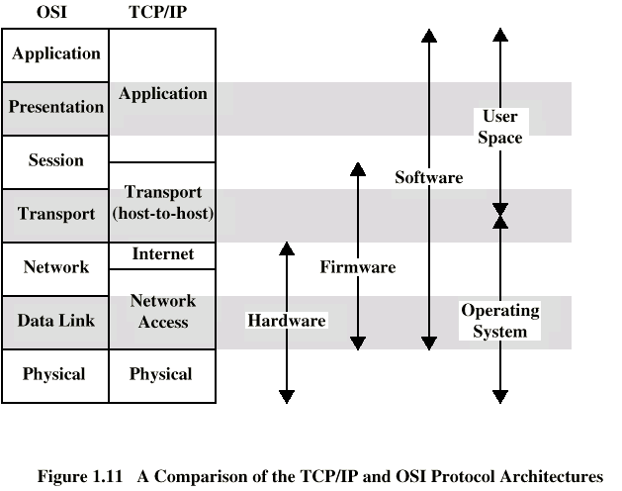
TCP/IP vs OSI Models
CE/CZ4023
Part II
Part I

Slide 22
Part I Syllabus
Date​​ | Subject​​ | File​​
Week 1:​​ 9/Jan/2023​​ 11/Jan/2023​​ | Introduction: course logistics and Internet history​​ | M1-L1-Introduction.pptx​​
 | Layered Network Architecture​​ | First part of M1-L2-Network Layer & Physical Resilience.pptx​​
Week 2:​​ 16/Jan/2023​​ 18/Jan/2023​​ | Physical Layer: Network Resilience​​ | Second part of M1-L2-Network Layer & Physical Resilience.pptx​​
 | Data link layer – Flow control​​ | M1-L3-DLL-Flow Control.pptx​​
Week 3:​​ 23/Jan/2023​​ 25/Jan/2023​​ | Data link layer – Error control​​ | M1-L4-DLL-Error Control.pptx​​
 | Local area network – Introduction​​ | M1-L5-LAN-Introduction.pptx​​
Week 4:​​ 30/Jan/2023​​ 01/Feb/2023​​ | Local area network – MAC​​ | M1-L6-LAN-MAC.pptx​​
 | Local area network – Ethernet​​ | First part of M1-L7-LAN-Ethernet.pptx​​
Week 5:​​ 06/Feb/2023​​ 08/Feb/2023​​ | Local area network – Ethernet Evolutions​​ | Second part of M1-L7-LAN-Ethernet.pptx​​
 | Local area network – WLAN​​ | M1-L8-LAN-WLAN.pptx​​
Week 6:​​ 13/Feb/2023​​ 15/Feb/2023​​ | Mobile Access Networks: From 1G to 5G ​​ | M1-L9-Mobile.pptx​​
 | Network paradigms​​ | M1-L10-Paradigms.pptx​​

Slide 23
Physical Layer: Network Resilience

Slide 24
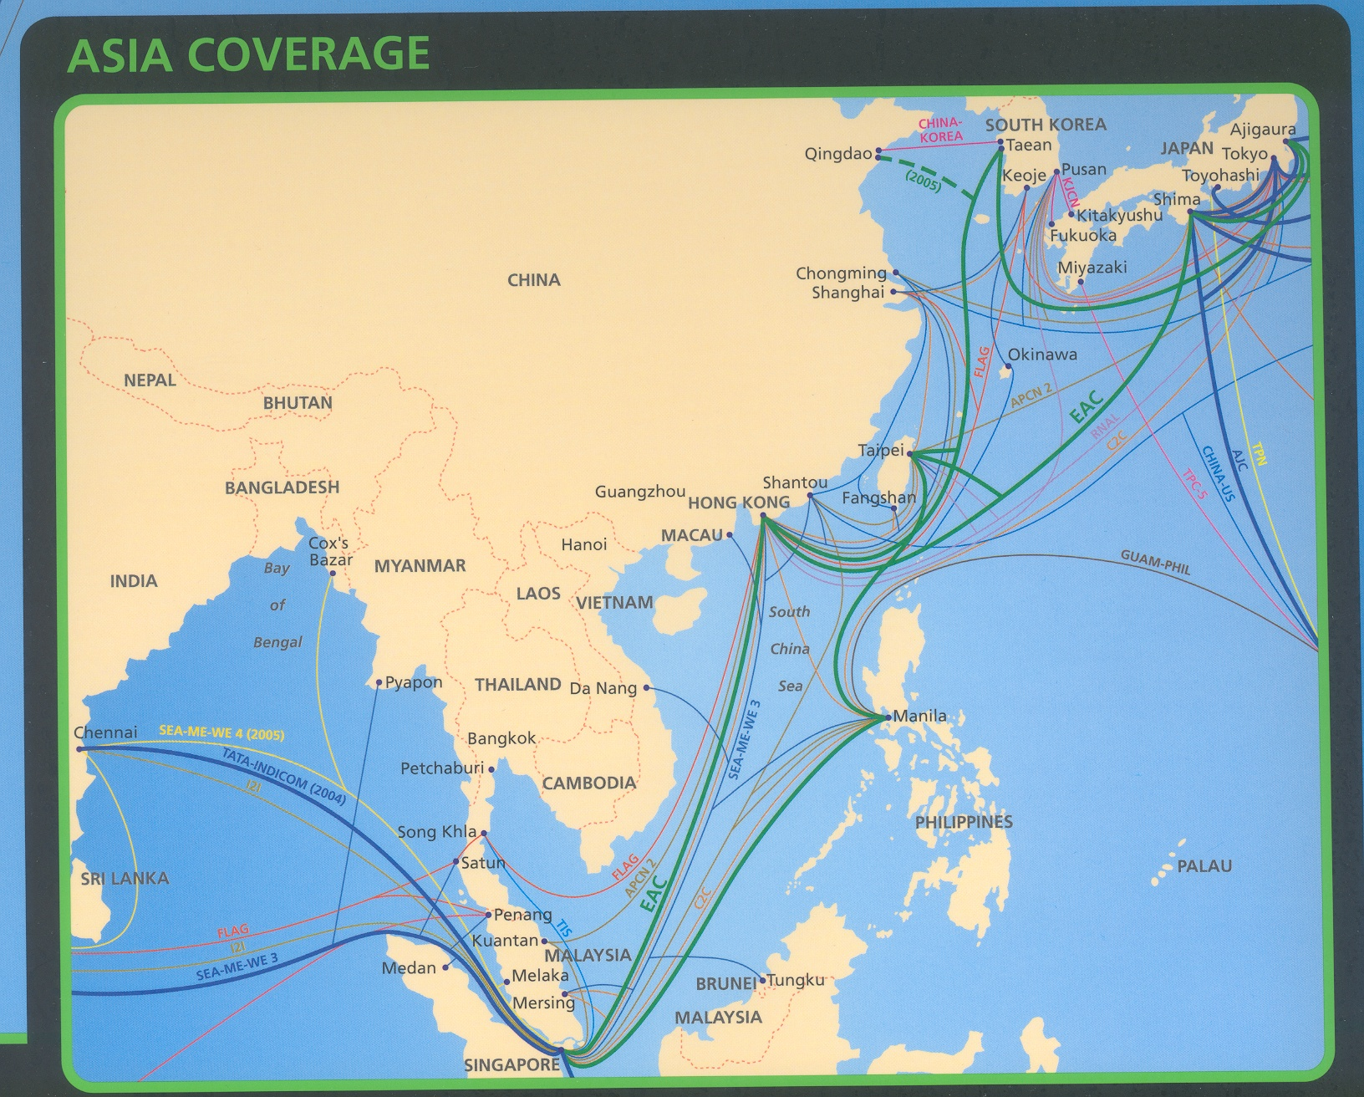
Use links for abstraction

Slide 25


GMT 12:26:01, 26 December 2006
Taiwan
7.1 magnitude quake
Multiple aftershocks
6 cable systems effected

Slide 26
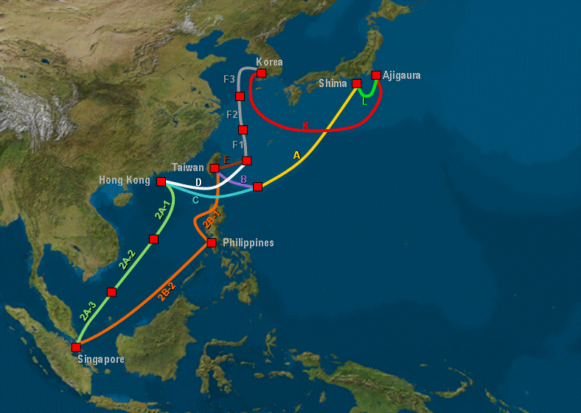
East Asia Crossing (EAC) Cable Network
N
Qingdao
N
M
Here the network topology is like a mesh,
so it is quite resilient.
A mesh network intuitively means there are
multiple paths between any two nodes.

Slide 27
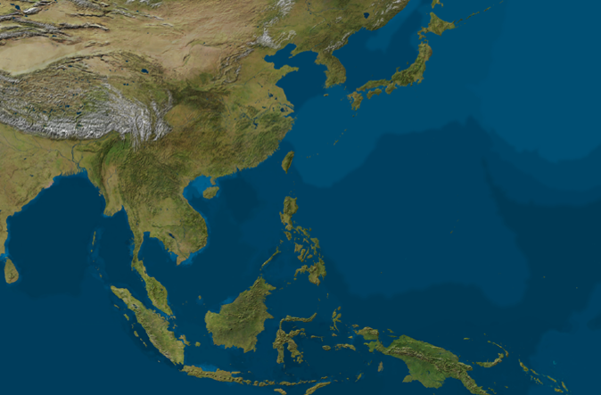
City-to-City (C2C) Cable Network
Pusan
Chikura
S3b
Shima
Shanghai
S3c
S4
S3a
Tanshui
S5
Hong Kong
Fungshan
S2c
S2b
S2a
S7
S1
Batangas
with a link broken becomes
Ring
Line
S6
Singapore
Here the network topology is like a ring,
so it is not that resilient.

Slide 28
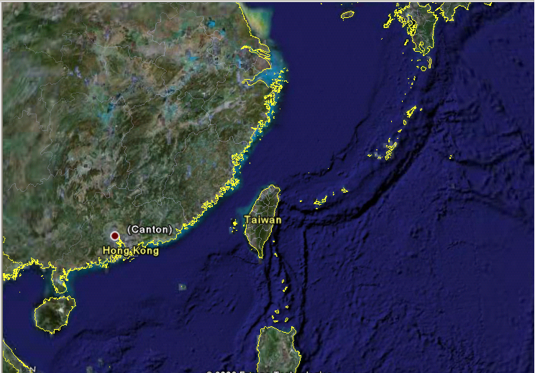
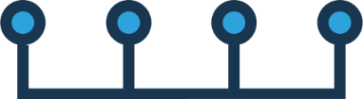
Other Cable Network
Here the network topology is like a ring,
so it is not that resilient.
N2
B1
N4
Miyazaki
Shanghai
N1
N6
N8
Here the network topology is like a bus,
so it is not that resilient.
N3
B2
S4
N5
N7
N9
B3
Okinawa
Ring/bus is less resilient than mesh,
but cheaper.
S3
S6
Pali
Tanshui
Toucheng
B4
S4
W1
S2
Shantou
Fangshan
S5
Macau
W2
S3
W3
B17
S7
APCN-2
B8
B5
APCN
S2
S1
China-US
S8
FNAL/RNAL
B7
Flag
SMW3
B9
B6
Philippines
Philippines

Slide 29
Network Reliability
Probability that a network performs satisfactorily over a period of time
Parameters:
Mean Time Between Failures (MTBF)
Mean Time to Failure (MTTF)
Mean Time to Repair (MTTR)
MTBF = MTTF + MTTR
Operation
time
MTTF
MTTR

Slide 30
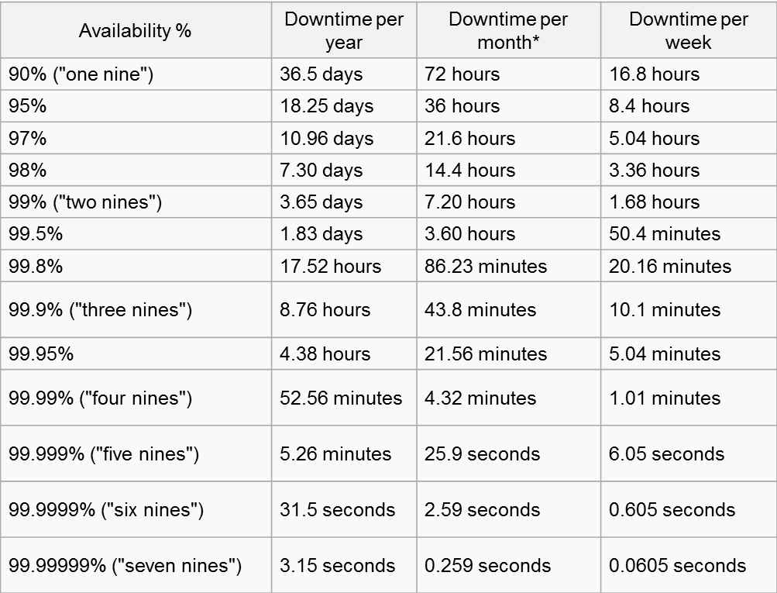
Link Failure Probability
Link Failure Probability: percentage of time during which the link is dysfunctional
Link Availability: percentage of time during which the link is functional
b_{i} : Probability link “i” is broken
r_{i} : Probability link “i” is available, i.e., not broken
r_{i} = 1 - b_{i}

Slide 31
Network Resilience Issues
What’s the probability of a link failure?
Are there alternative paths?
Is there a single point of failure ?
What is the probability for two nodes to stay connected in a network?

Slide 32
Network Resilience
A measure of Network Fault Tolerance
Express in terms of probability that the network remains connected.
Assumptions
The probability of link failures are independent of each other.

Slide 33
Network Availability: Single Link
SG
AU
Given that the failure probability of the link is 0.05,
Failure probability: b_{SG-AU} = 0.05
Availability probability: r_{SG-AU} = 1-0.05 = 0.95

Slide 34
Network Availability: Series
SG
HW
AU
Given that each link has a failure probability of 0.05,
Prob that SG can communicate with AU:
r_{SG-HW-AU} = Pr [both links survive] = r_{SG-HW} * r_{HW-AU} = (1-0.05)*(1-0.05)
= 0.9025
What is the probability that SG cannot communicate with AU?
b_{SG-HW-AU} = 1-0.9025 = 0.0975
Computing 1 - r_{SG-HW} * r_{HW-AU} above is easier than summing the three products below:
b_{SG-HW} * b_{HW-AU}
b_{SG-HW} * r_{HW-AU}
SG
HW
AU
AU
SG
HW
r_{SG-HW} * b_{HW-AU}
SG
HW
AU

Slide 35
Network Availability: Parallel
SG
AU
Link B
Given that each link has a failure probability of 0.05,
What is the probability that SG is isolated from AU ?
Prob(break) = Pr[both links break]
= b_{A} * b_{B}
= 0.05 * 0.05 = 0.0025
SG
AU
b_{SG-AU} = 0.0025

Slide 36
Hybrid Graphs: Path-Based Approach
SG
0.05
HW
0.05
AU
0.05
Given that each link has a failure probability of 0.05,
Calculate the Prob that SG is isolated from AU.
r_{SG-HW-AU} = r_{SG-HW} * r_{HW-AU}
= (1-0.05)*(1-0.05)
= 0.9025
b_{SG-HW-AU} = 1- r_{SG-HW-AU}
= 1-0.9025
= 0.0975
Prob. SG Disconnected from AU = b_{SG-HW-AU} * b_{SG-AU}
= 0.0975 * 0.05
= 0.004875

Slide 37
Rules for Network Availability
Link in series
Calculate that probability that all links in the series are working
Link in parallel
Calculate the probability that all links are broken.
Combination of series and parallel
Decompose them into paths
Calculate network availability using path-based approach

Slide 38
Learning Objectives
Layered Network Architecture
Why layering?
OSI model and its functions
TCP/IP model and its functions
Mapping between OSI and TCP/IP Models
Physical Layer Resilience
Definition of link availability and calculation
Path-based approach

Slide 39
Supplementary Materials
Remark:
For the supplementary materials in the lecture notes, they are not examinable but as the reference for you to better understand the lecture.
However, some of the content in the supplementary may appear in other slides (not in the supplementary). And if so, this content is examinable.

Slide 40
Physical Layer
Provides physical interface for transmission of information
Defines rules by which bits are passed from one system to another on a physical communication medium
Covers all – mechanical, electrical, functional and procedural – aspects for physical communication
Such characteristics as voltage levels, timing of voltage changes, physical data rates, maximum transmission distances, physical connectors, and other similar attributes are defined by physical layer specifications

Slide 41
Data Link Layer
Data link layer attempts to provide reliable communication over the physical layer interface
Breaks the outgoing data into frames and reassemble the received frames
Create and detect frame boundaries
Handle errors by implementing an acknowledgement and retransmission scheme
Implement flow control
Supports points-to-point as well as broadcast communication
Supports simplex, half-duplex or full-duplex communication

Slide 42
Network Layer
Implements routing of frames (packets) through the network
Defines the most optimum path the packet should take from the source to the destination
Defines logical addressing so that any endpoint can be identified
Handles congestion in the network
Facilitates interconnection between heterogeneous networks (Internetworking)
The network layer also defines how to fragment a packet into smaller packets to accommodate different media

Slide 43
Transport Layer
Purpose of this layer is to provide a reliable mechanism for the exchange of data between two processes in different computers
Ensures that the data units are delivered error free
Ensures that data units are delivered in sequence
Ensures that there is no loss or duplication of data units
Provides connectionless or connection oriented service
Provides for the connection management
Multiplex multiple connection over a single channel

Slide 44
Session Layer
Provides mechanism for controlling the dialogue between the two end systems. It defines how to start, control and end conversations (called sessions) between applications
Requests for a logical connection to be established on an end-user’s request
Any necessary log-on or password validation is also handled by this layer
Session layer is also responsible for terminating the connection
This layer provides services like dialogue discipline which can be full duplex or half duplex
Session layer can also provide check-pointing mechanism such that if a failure of some sort occurs between checkpoints, all data can be retransmitted from the last checkpoint

Slide 45
Presentation Layer
Presentation layer defines the format in which the data is to be exchanged between the two communicating entities
Also handles data compression and data encryption (cryptography)

Slide 46
Application Layer
Application layer interacts with application programs and is the highest level of OSI model
Application layer contains management functions to support distributed applications
Examples of application layer are applications such as file transfer, electronic mail, remote login etc.

